Slide 1





⥫
From Zero to ASP.NET: Crafting Your First Project
Step by Step!

Slide 2





Welcome to ASP.NET!
In this journey, we will explore the
of ASP.NET, a powerful framework for building dynamic web applications.
Get ready to dive into the world of and as we craft your first project step by step!

Slide 3






Setting Up Your Environment
To begin, you need to install the , and a suitable like Visual Studio. This setup is crucial for creating
and managing your ASP.NET projects efficiently. Let’s ensure your environment is ready for !

Slide 4






Building Your First Project
Now, let's create your first ASP.NET project! Start by selecting the template in Visual Studio. This template will provide you with a solid foundation to build upon, allowing you to focus on
rather than configuration.

Slide 5



Conclusion & Next Steps
Congratulations! You've taken the first steps in your ASP.NET journey. By mastering the basics, you can now
explore more advanced topics like ,
and . Keep experimenting and happy coding!
,

Slide 6
⥫
Developing a Robust Connection String: Step-by-Step Guide
for ASP.NET Projects

Slide 7

Introduction to Connection Strings
In projects, a is crucial for establishing a link between your application and the database. This guide will walk you through the essential steps to
create a
connection string, ensuring in your
and applications.

Slide 8






Understanding Connection String Components
A typically includes
several key components: ,
, , and .
Understanding these elements is essential for configuring your connection correctly and maintaining access to your database.

Slide 9




Best Practices for Security
To enhance the
or
of your connection string, consider using
. Avoid hardcoding sensitive
information directly in your code. Instead, utilize
or environment variables for safer management of your credentials.

Slide 10
Conclusion and Key Takeaways
Developing a robust connection string is vital for any project. By following the outlined steps and adhering to best
practices, you can ensure a and efficient connection to your database, which is essential for the of your application.

Slide 11
⥫
Understanding the Role and Necessity of Click Events in
ASP.NET Web Forms

Slide 12


Introduction to Click Events
In , are crucial for user interaction. They enable developers to handle user actions effectively, making web applications dynamic and responsive. Understanding how to implement and manage these events is essential for creating robust web applications that enhance user experience.

Slide 13
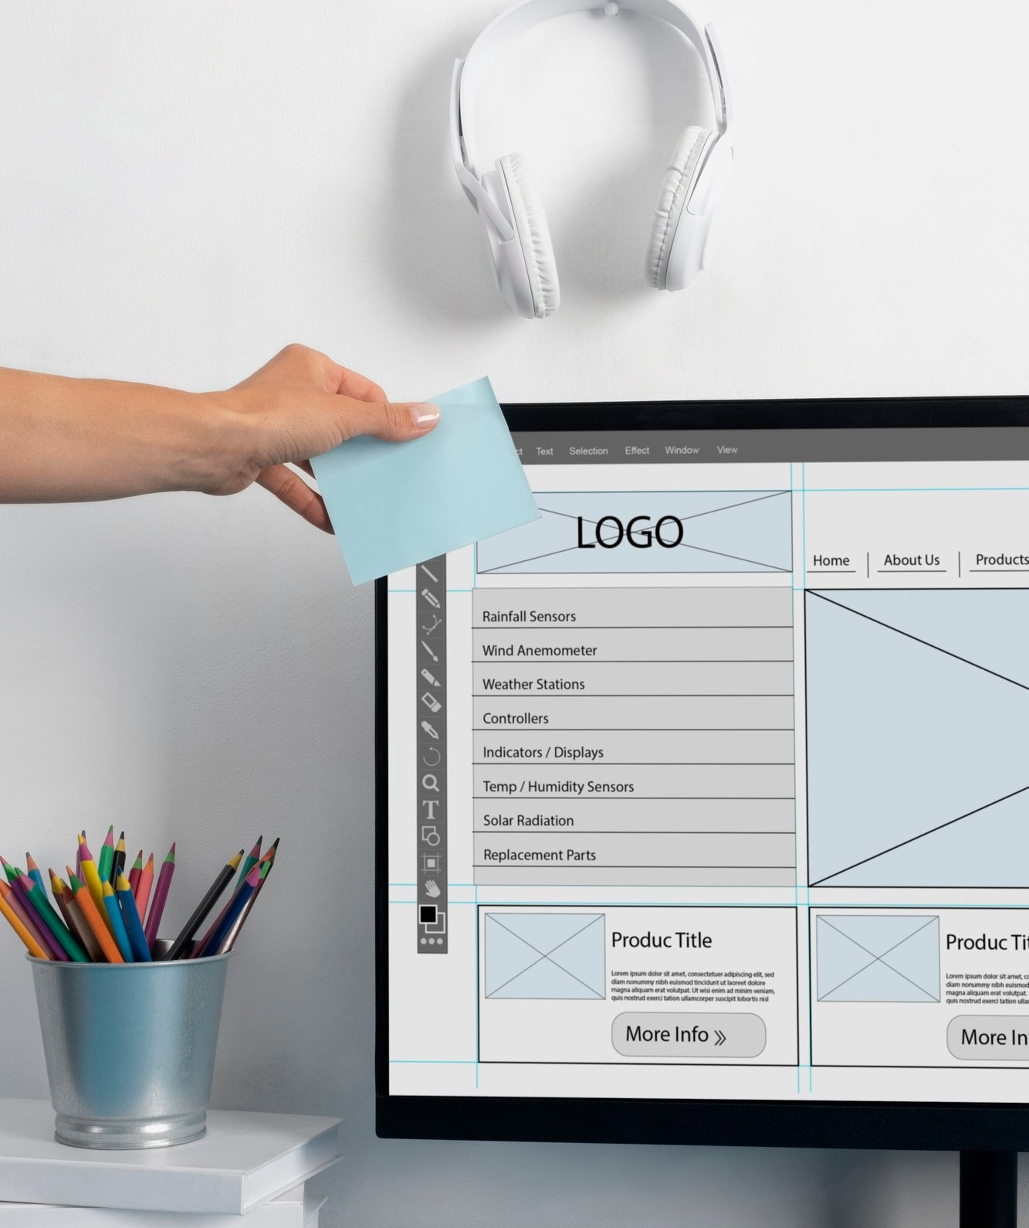

How Click Events Work
Click events are triggered when a user interacts with elements like buttons. In , these events are linked to server-side methods, allowing for without needing to refresh the page. This process enhances the
by providing immediate feedback and functionality.

Slide 14

Implementing Click Events
To implement click events in , developers use the OnClick attribute in button controls. This links the button to a server-side method that executes when the button is clicked. Properly managing these events is vital for ensuring and performance.

Slide 15
Conclusion
Understanding in is essential for developing interactive web applications. They provide a mechanism for handling user input efficiently, enhancing overall user engagement and satisfaction. Mastery of these events leads to better application performance and user experience.

Slide 16











Thanks!
BY HARSH Devre
itmbu.harsh@gmail.com
+91 87994 42030

